Slide 1

MANUFACTURING PROCESS-I
COURSE PROJECT

Slide 2
TEAM MEMBERS
(B.Tech 2nd Year)
IIT-DH
SIDDHARTHA PRASAD (210030033)
KOOSU VISWAS (210030016)
SWAPNESH SINHA(210030036)

Slide 3

e-SCOOTER

Slide 4
Index
e-Scooter
Introduction to e-scooter
Construction of e-scooter
Details of parts
DC Rechargeable battery
Motor in-built tyres
Rubber castor wheels
Mild steel tubes
Mild steel sheet
Motor controller
ESC(tried to lower the price)

Slide 5
Index
Development
Manufacturing processes involved
List of figures
Block diagram of scooter
Working
Advantages
Limitation
Future development
Conclusion
Acknowledgement

Slide 6
E-Scooter
Introduction to e-scooter
Electric motorcycles and scooters are plug-in electric vehicles with two or three wheels. Power is supplied by a rechargeable battery which drives one or more electric motors. Electric scooters are distinguished from motorcycles by having a step-through frame, instead of being straddled. Electric bicycles are similar vehicles, distinguished by retaining the ability to be propelled by the rider pedalling in addition to battery propulsion.
Electric scooters with the rider standing are known as e-scooters.
Charging
All electric scooters and motorcycles provide for recharging by plugging into ordinary wall outlets, usually taking about eight hours to recharge (i.e., overnight). Some manufacturers have designed in, included, or offer as an accessory, the high-power CHAdeMO level 2 charger, which can charge the batteries up to 95% in an hour.

Slide 7
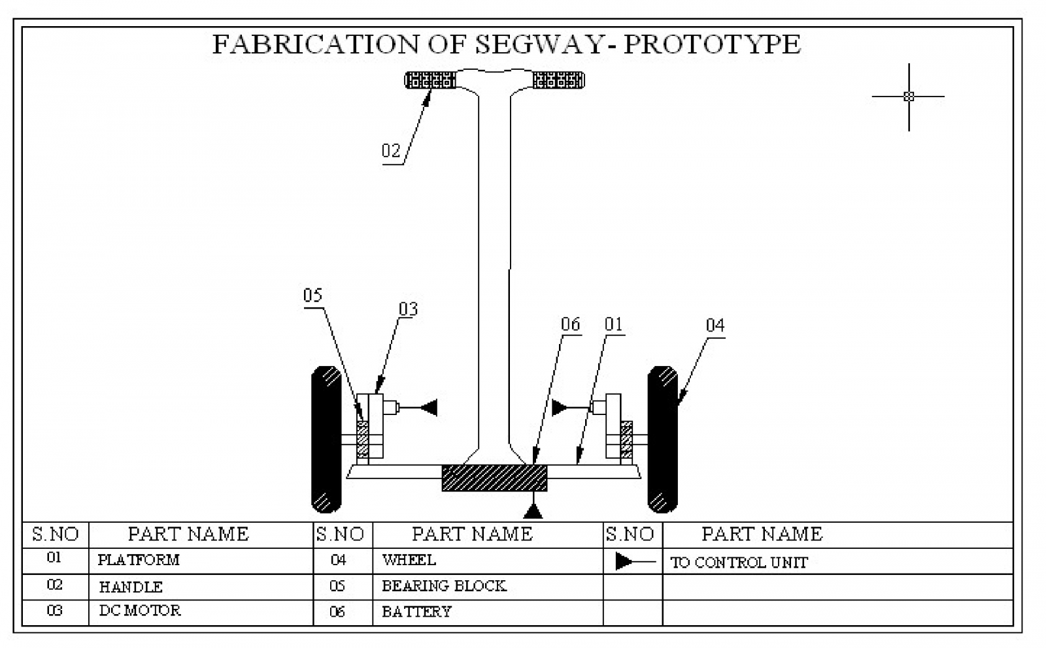
Construction of e-scooter
Building an electric scooter starts with two key components: the scooter frame and motor. There are two main types of motor drives for DIY scooters: belt/gear driven, or direct drive such as a hub motor. I opted for a brushless hub motor.

Slide 8
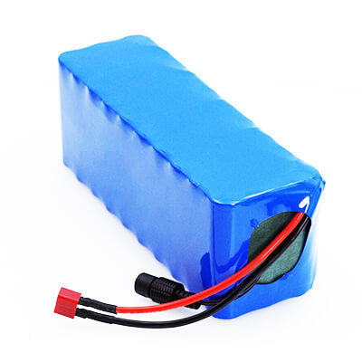
Details of parts
DC rechargeable battery
LRSA 24V 10Ah LITHIUM-ION RECHARGEABLE BATTERY PACK with Charger | Ebike, ECycle Battery 24volts 10Amps
Quantity - 1
https://lrsa.in/product/24v-10ah-lithium-ion-rechargeable-battery-pack-with-charger/
Very Small in size and weight compared to Ni-Cd, Ni-MH, and Lead Acid Batteries
Full Charge in 40 to 90 minutes depending upon the special charger
Long life with full capacity for up to 1000 charge cycles
Low maintenance
Connector Pin Type - 5.5X2.5
Power Input - 100-240,50-60HZ
Output Current (A) - 3 A
Cable Length (m) - 1.5 m
Short Circuit Protection - Yes

Slide 9
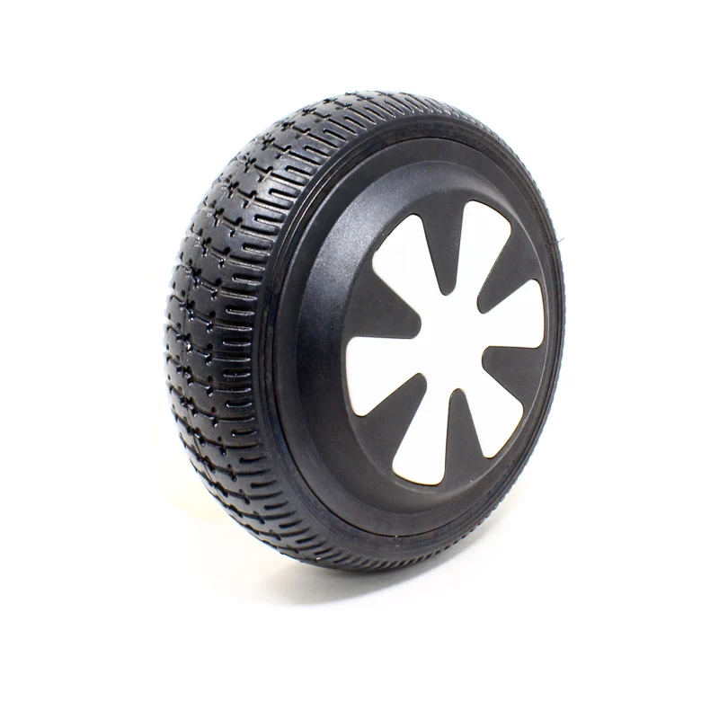
Motor in-built tyres
6 Inch 250W 24V Brushless Hub Motor with Tyre for E-bike
Quantity - 2
Max speed: 28 km/h.
Weight: 2.1 kg
Shaft Type: D-type
Shaft Length: 50 mm
Shaft Diameter: 16mm (ROUND SIDE); 14.5 (FLAT SIDE)
This is a 6 Inch 250w 24v Brushless Hub Motor with Tyre for E-bike. This monster Hub Motor is for Self-balancing Cars & Scooters.
Hub motor has a size of 13cm (with a tyre of 16.5cm) and comes with an airless tyre. The motor has connection wires for the hall sensor and temperature controller making it easier to control. One can use this Hub motor and Tyre combo in Self-balancing Car, Electric Scooter, Skateboard, Ebike, ATV, Electric Roller, DIY Conversion Kit, E-Scooter, etc

Slide 10
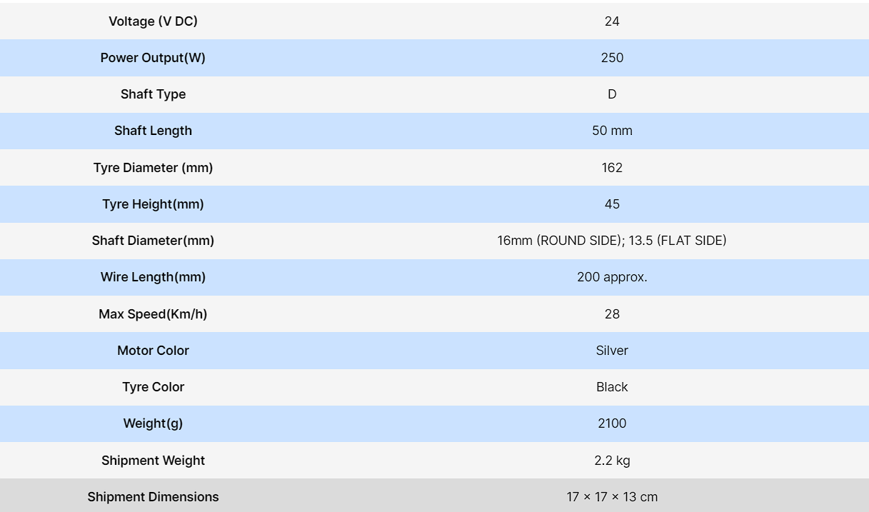
specifications

Slide 11
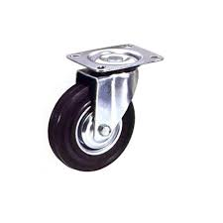
Rubber castor wheels
Quantity - 2
Material - rubber,steel
Size - 2-3 inches
Maximum load - 100 kg

Slide 12
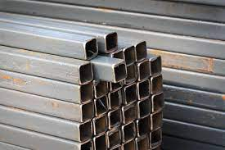
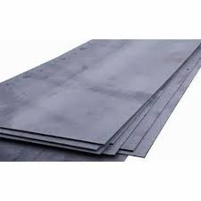
Mild steels tube
Mild steels sheets
square tube (1 inch, 1.2 mm thick)
Quantity - 220-240 inches
MS sheet (1.2 mm)
Quantity - 2 X 50 X 35 cm

Slide 13
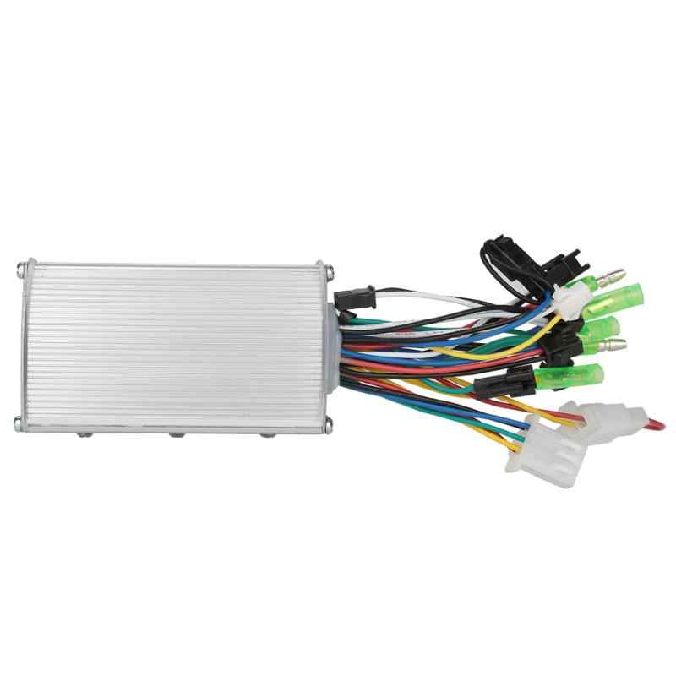
Motor controller
Brushless Controller 24V for Hub Motor 250W
https://robu.in/product/brushless-controller-24v-for-hub-motor-250w/
Rated voltage: 24V
Rated Power: 250W
Current: 16±1 A
Under Voltage: 21±0.V
The 24v 250W Hub Motor Popularly known as a general application motor. It is extremely durable and reliable. Its Commonly found in 24V scooters or even small kiddies carts and It’s also been a proven motor in robotics. Get Brushless Controller for this Hub Motor. The e-bike controller is the brain of the e-bikes. It is connected to all the other electronic parts such as the battery, motor, and throttle if it exists. It takes all the inputs from all the other components and determines what should be signalled to them in return.

Slide 14
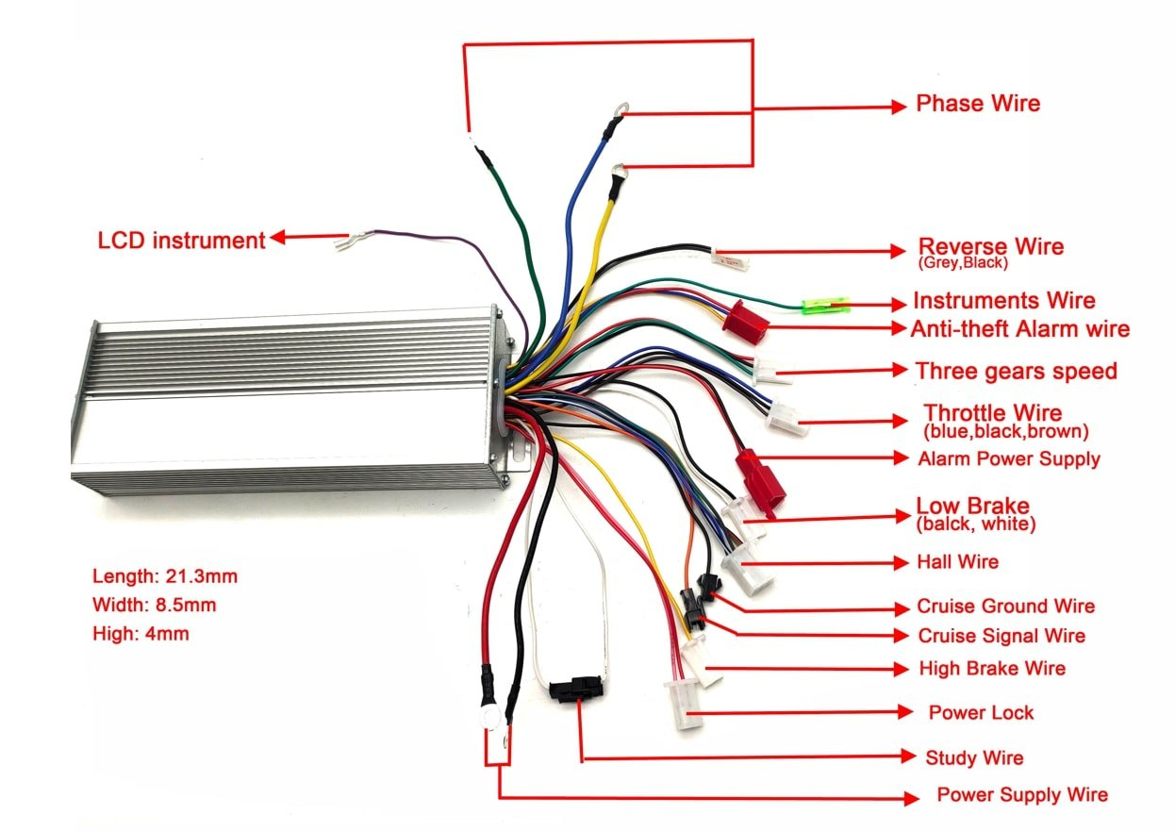

Slide 15
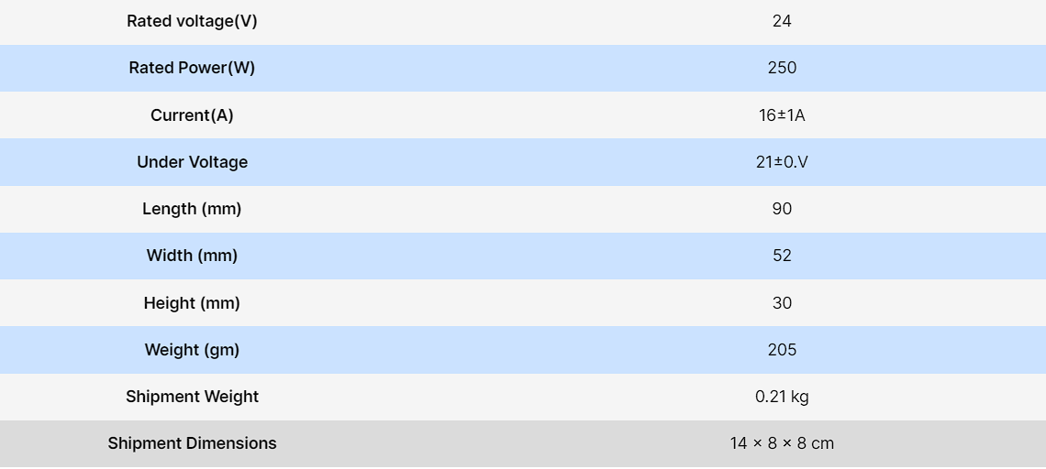
specifications

Slide 16
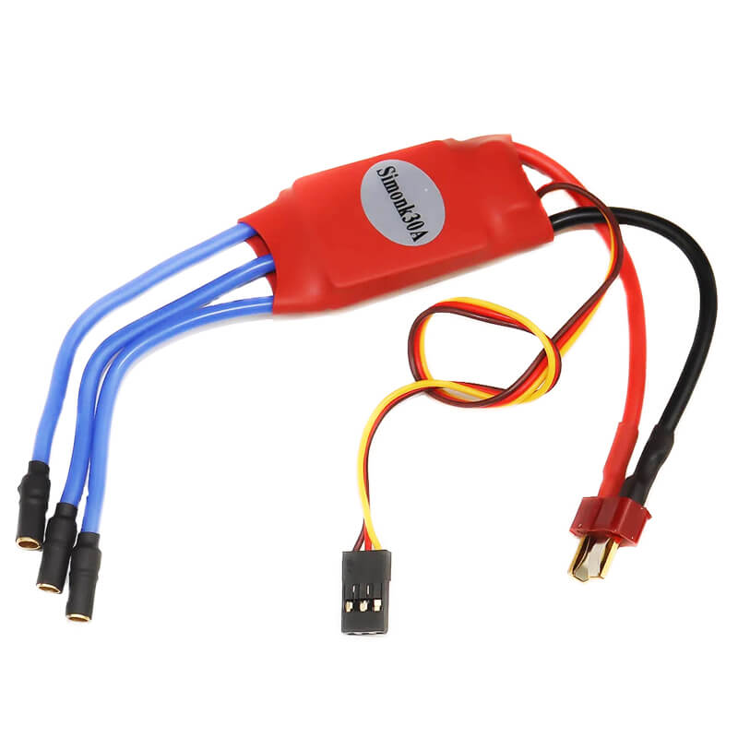
ESC (ELECTRONIC SPEED CONTROLLER)
Specifications :
11.2 V , 30 A

Slide 17
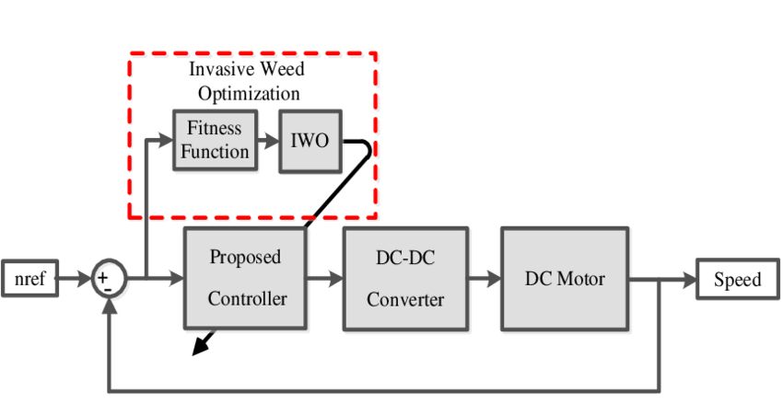
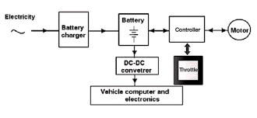
Development
Block diagram

Slide 18
Development
The manufacturing processes involved are:
DRILLING
GAS AND ARC WELDING
METAL CUTTING
GRINDING
SOLDERING

Slide 19
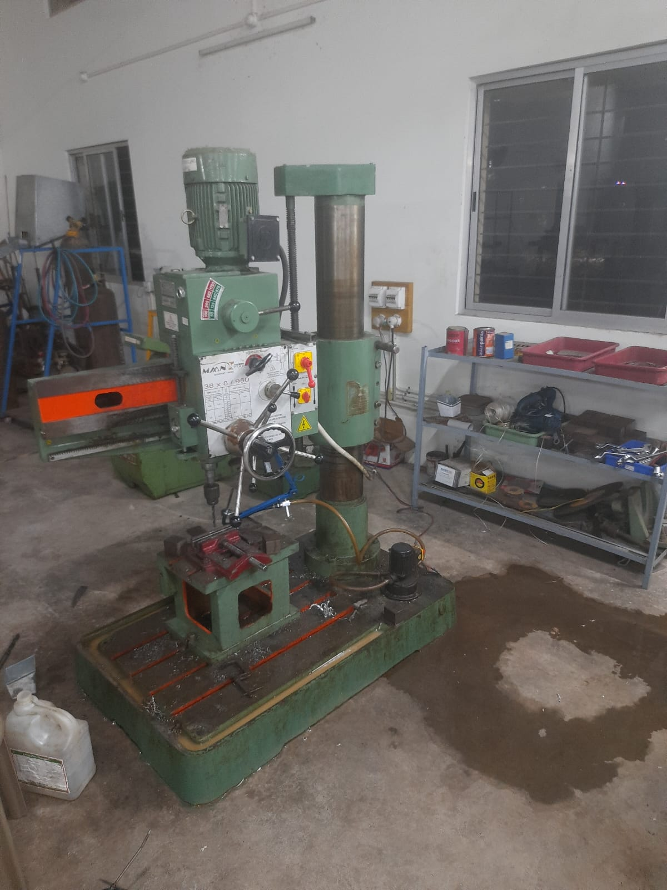
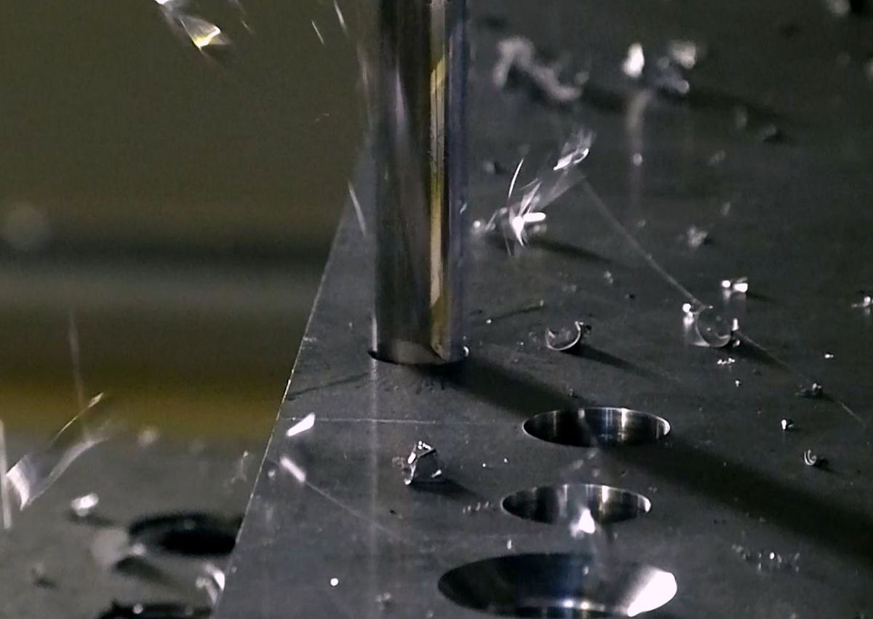
DRILLING
We used portable hand drilling and radial drilling processes.

Slide 20
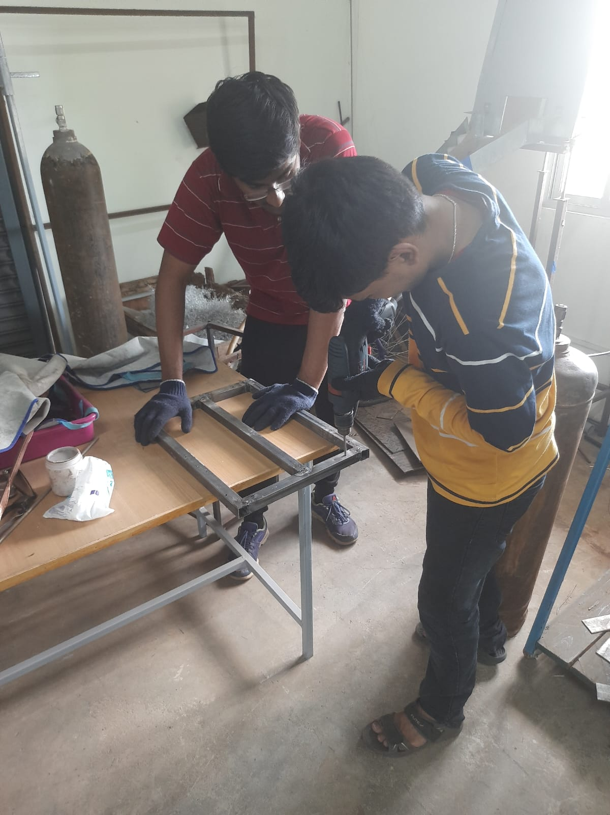
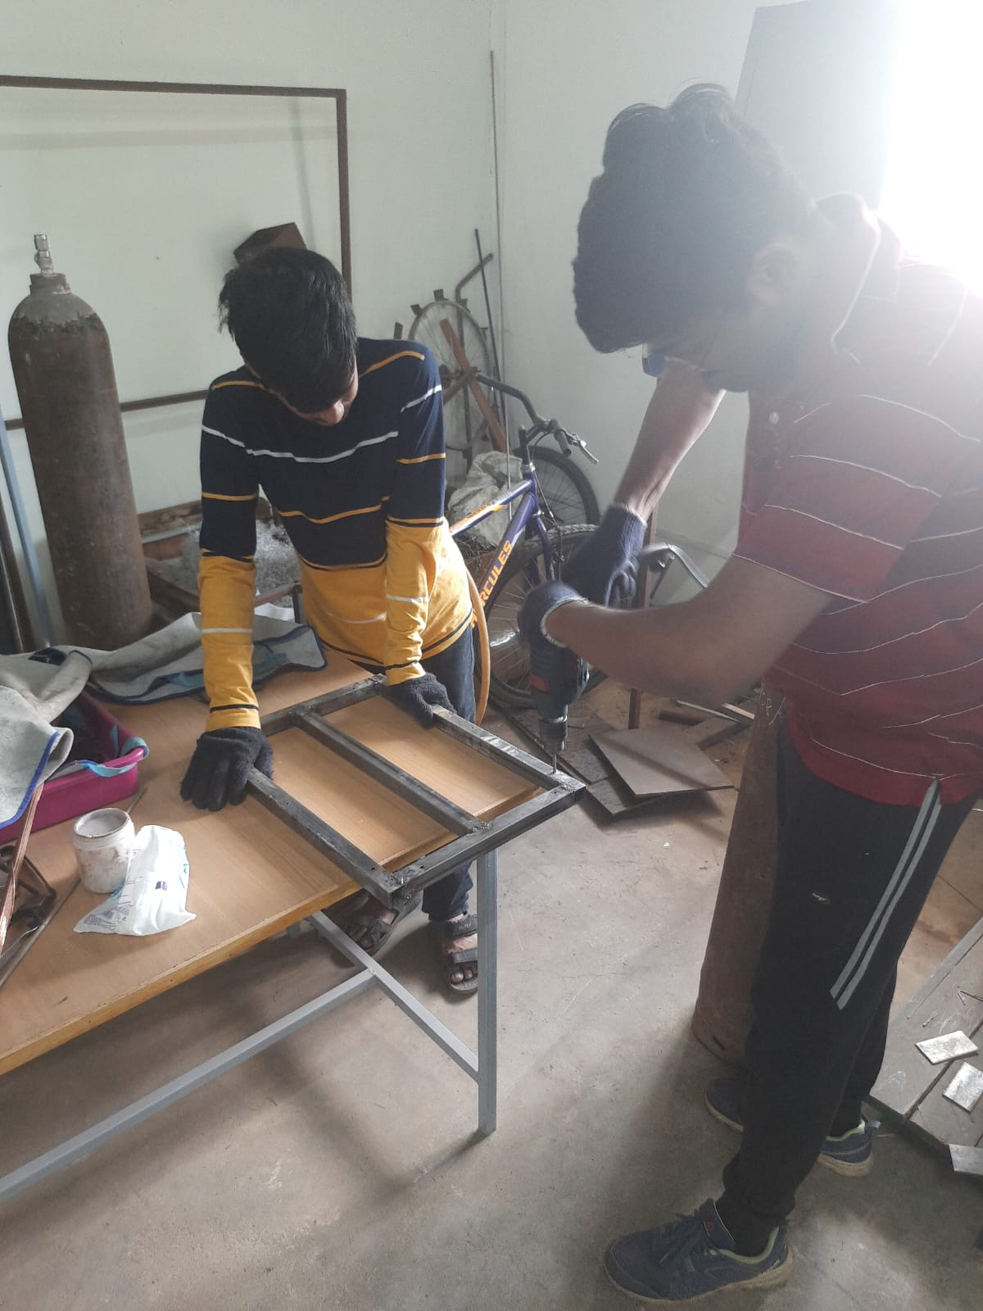

Slide 21



Slide 22
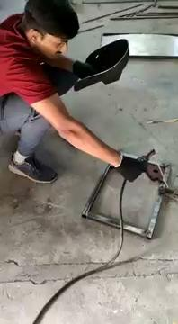
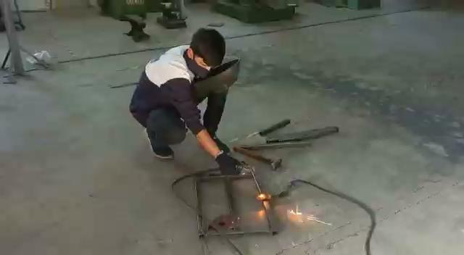
WELDING
We used arc welding and gas welding.

Slide 23

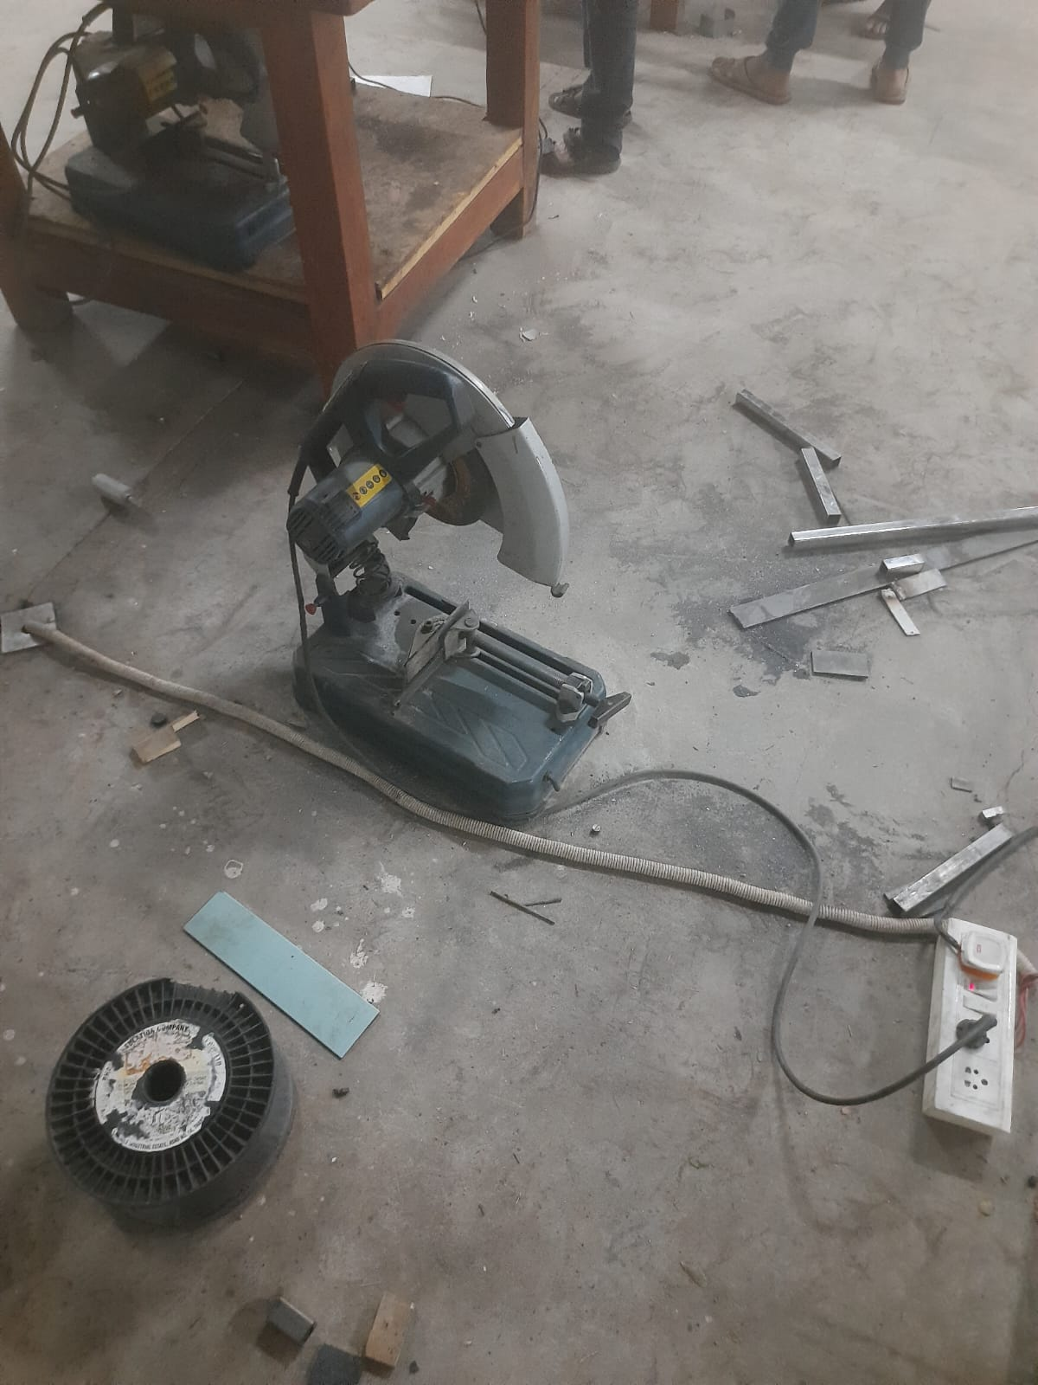
METAL CUTTING
We used mechanical cutting machine.

Slide 24
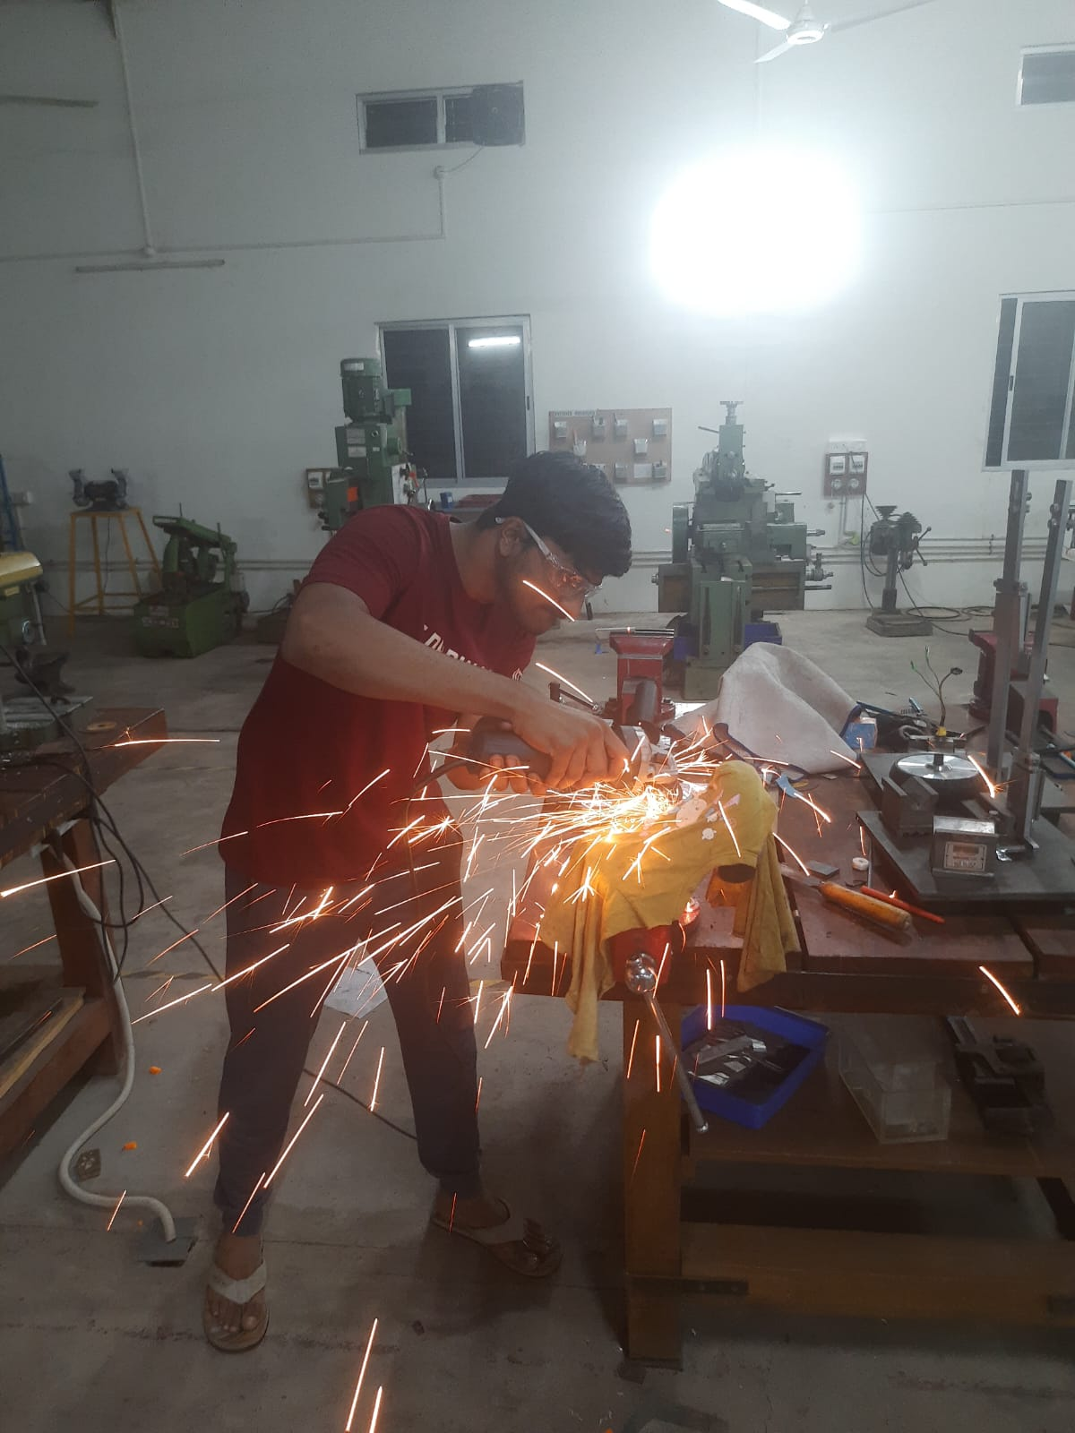
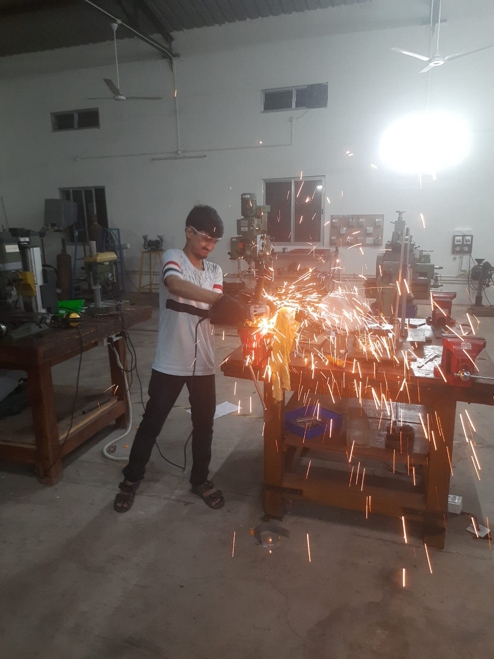
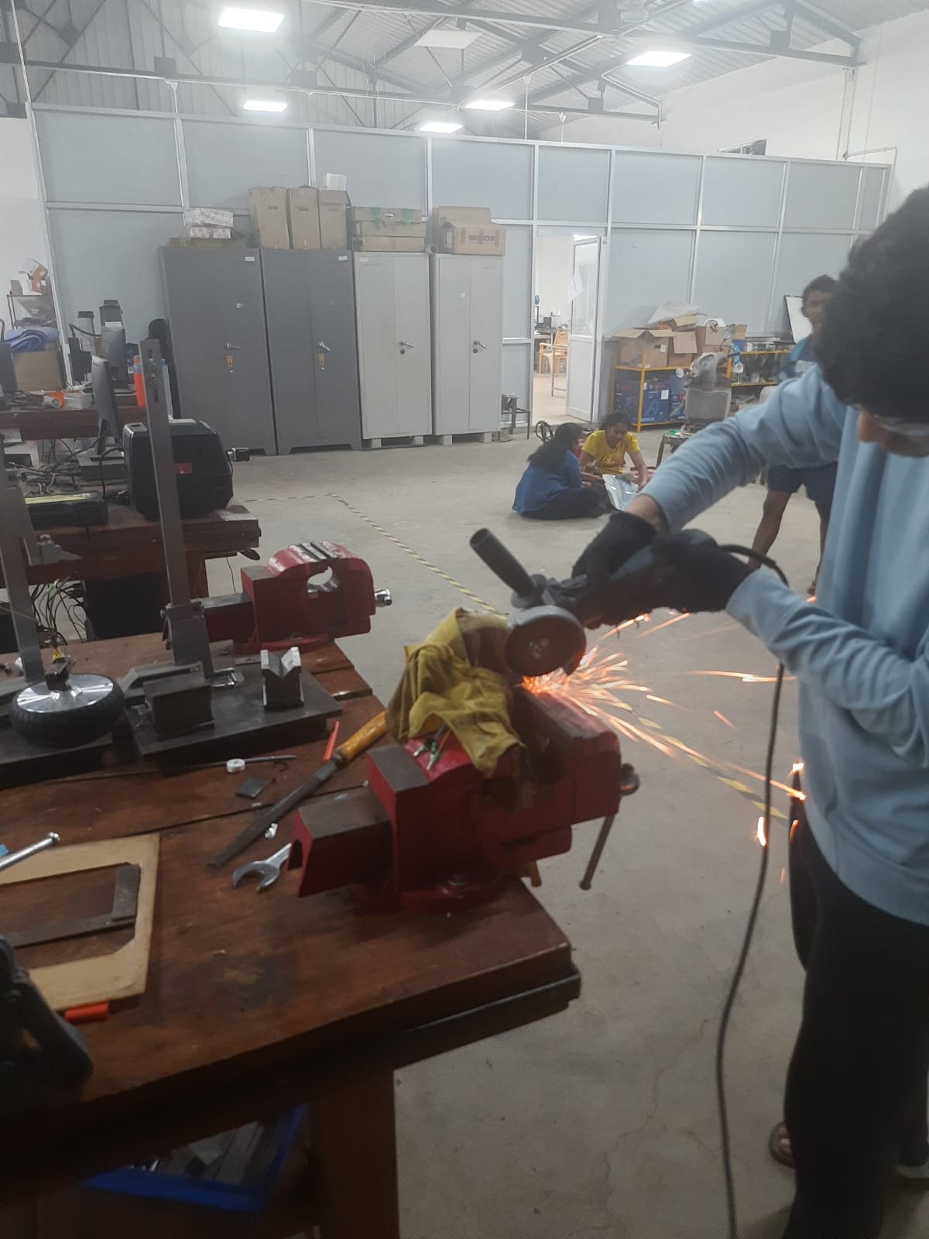
We used mechanical cutting machine.

Slide 25
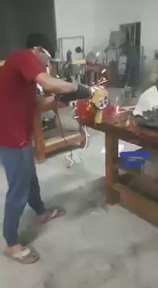
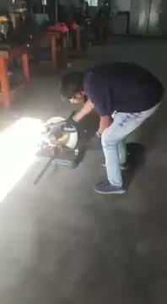

Slide 26
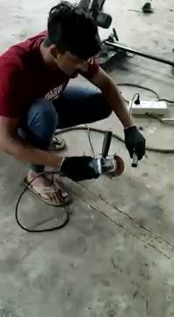
GRINDING

Slide 27
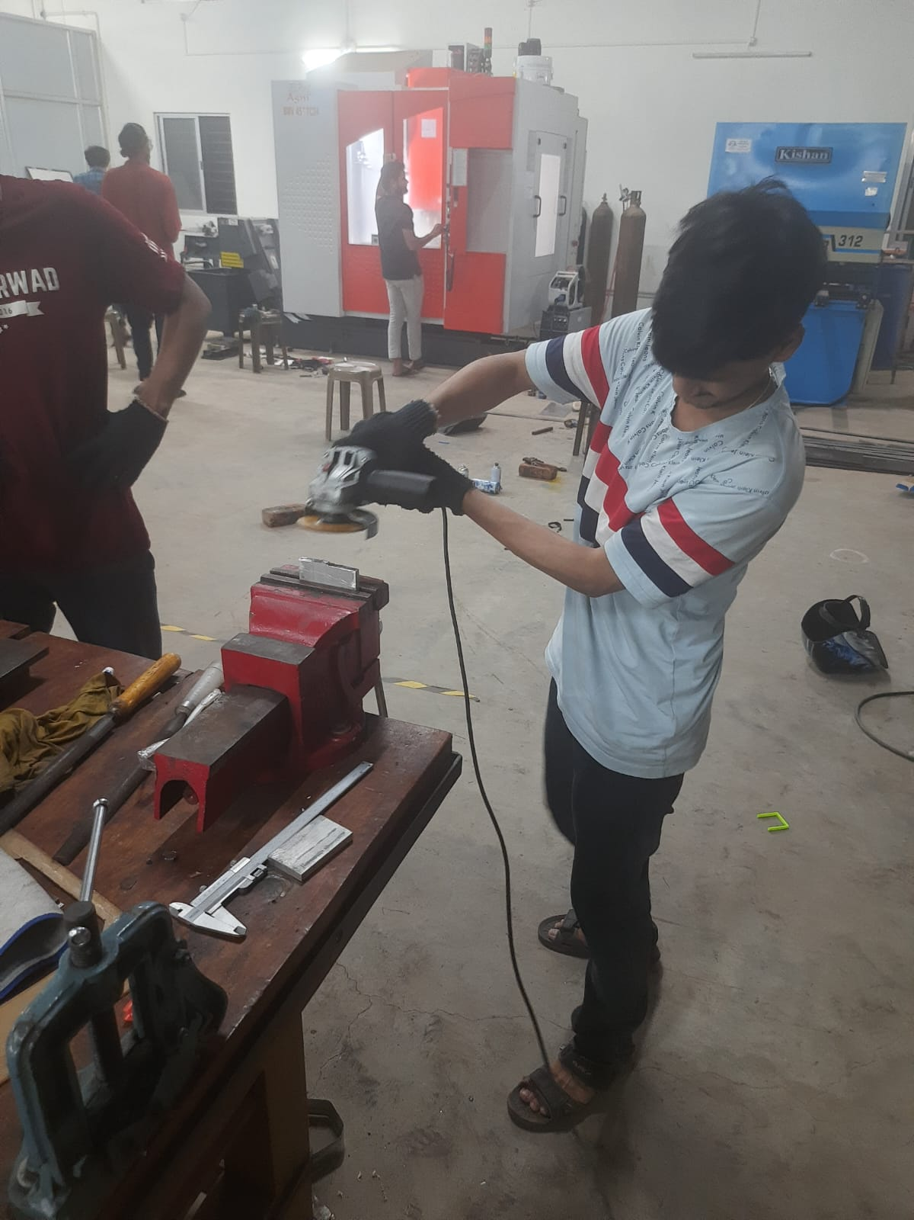

Slide 28
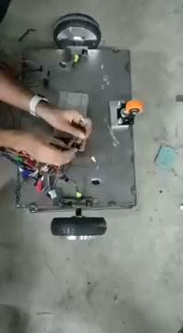
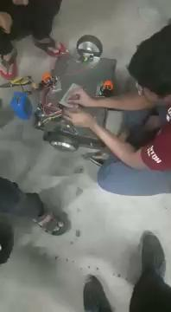
WORKING
#

Slide 29
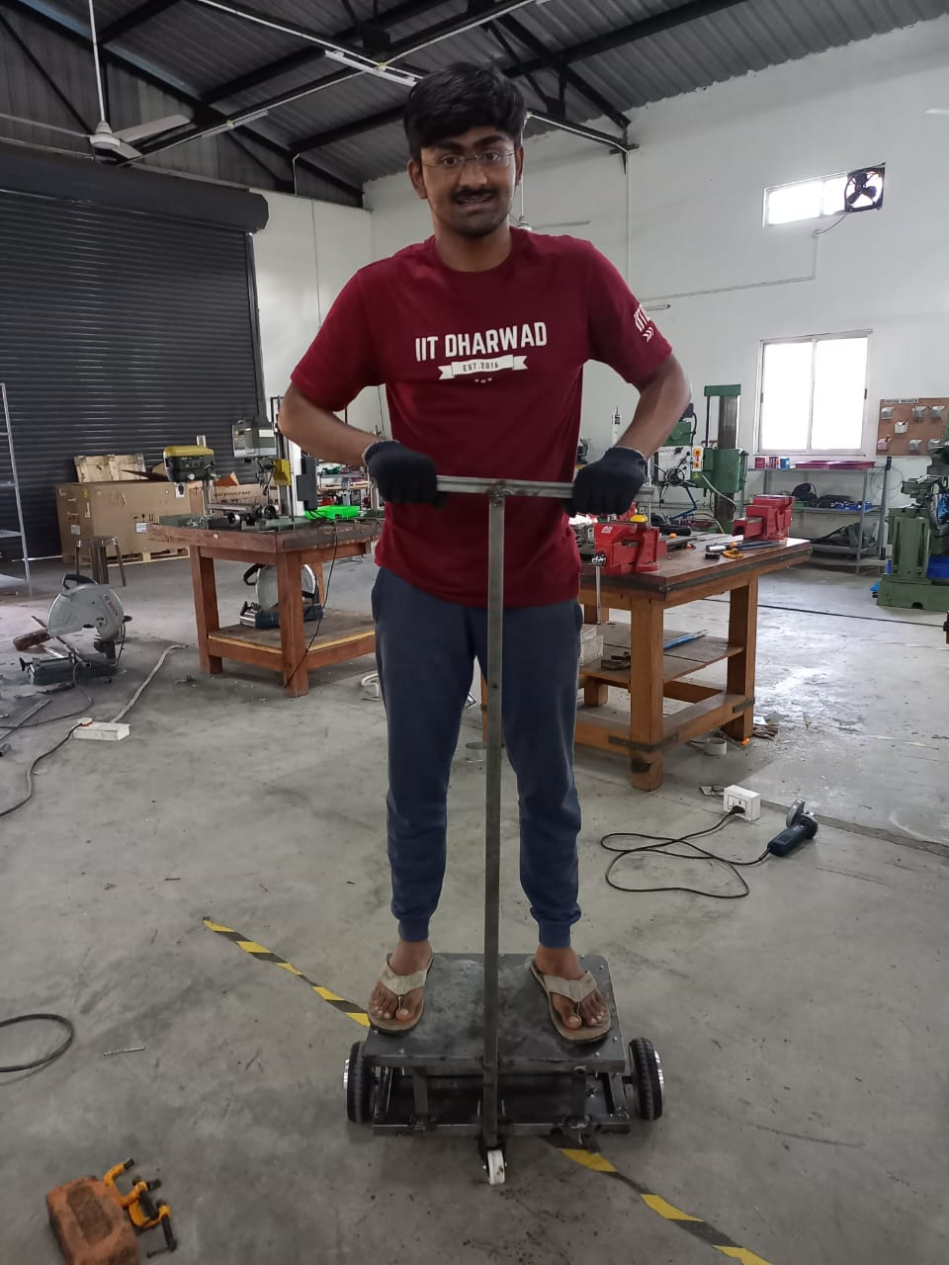
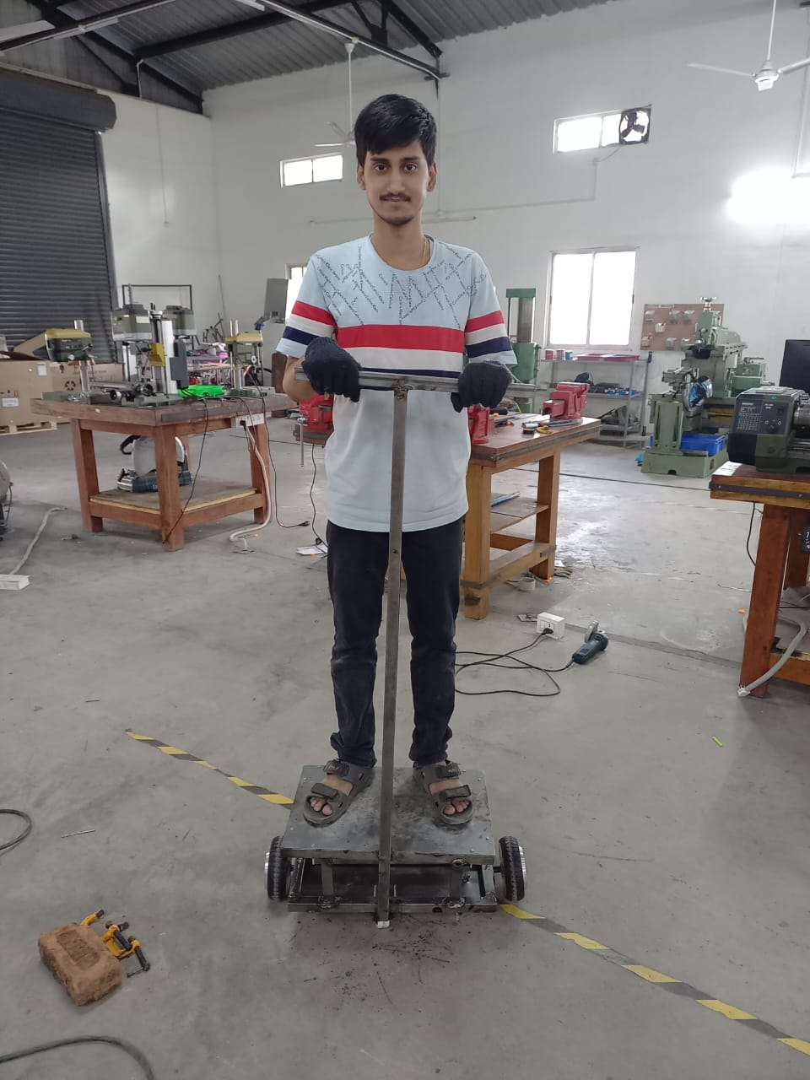
WORKING

Slide 30
ADVANTAGES OF e-SCOOTER
Safe, convenient, and easy to use
Light and portable
Relatively eco-friendly
Low operating costs
Easy repair and maintenance
Perfect for short distances
Less noise pollution
Mobility for those with health issues
Does not require license to drive

Slide 31
LIMITATIONS OF e-SCOOTER
High purchase price for electric scooters
Overcharging and other battery issues
Only suitable for short distances
May not be suitable for obese persons
Relatively slow compared to cars or motorcycles
May be dangerous without sufficient scooter lanes

Slide 32
FUTURE DEVELOPMENTS
We want to extend this project further with some new goals like:
Self balancing
Speed controlling / throttle accelerator
Braking system
Handle controlling
ADMS a e-bike manufacturing company, they have agreed to help us in making a self - balancing e- scooter.

Slide 33
CONCLUSION
In conclusion, the manufacturing of an electric scooter is a complex process that requires careful planning and attention to detail. Through our course project, we have gained a deep understanding of the various aspects involved in the production of an electric scooter, from the design phase to the final assembly.
We have explored the importance of selecting the right materials and components, as well as the need for rigorous quality control throughout the manufacturing process. We have also considered the environmental impact of electric scooters and the importance of sustainability in the production process.
Overall, our course project has been a challenging but rewarding experience that has equipped us with the skills and knowledge necessary to tackle real-world manufacturing problems. We hope that our project has inspired others to pursue sustainable manufacturing practices and to consider the impact of their products on the environment.

Slide 34
ACKNOWLEDGEMENT
We would like to extend this seminar by acknowledging several people who have helped us immensely for the completion of our project ,
first of all Prof. Somashekara M A for having manufacturing process course project idea, it really helped us to work on mechanical field and gain experience in manufacturing.
Secondly we would like to thank JTS .BHIMSEN sir for providing the space and materials to work.
We would also like to thank mechanics of our workshop who helped us a lot and guided us while making this project.
Lastly we would like to thank Rudra our batchmate who came to help while we were facing some problem and really clutched it.
Thank you!

